Slide 1
Introduction to Statistics

Slide 2
The word statistics conveys a variety of meanings to people. Basically Statistics is about extracting meaning from data.
Statistics or statistical methods are playing an increasingly important role in all phases of human life.
Commonly we find tables, charts figures in news papers, journals, books, various reports, classroom lectures, television programmes etc.

Slide 3
Whenever numbers are collected and compiled, regardless of what they represent, they become statistics.
Precisely statistics means presenting and handling data, making inferences logically and drawing relevant conclusions.
Thus the word statistics refers either to quantitative information or to a method of dealing with quantitative information.

Slide 4
Statistics Definition:
Some of the definitions are:
“The classified facts representing the conditions of the people, especially those facts which can be stated in numbers or in table of numbers or in any tabular or classified arrangement” – Webster

Slide 5
Sampling & Sample Design Sampling Process- Sampling Methods and Techniques: Random and Non-Random Sampling

Slide 6
Introduction to Population and Sample
Content:
Definition of population
Definition of sample
Importance of understanding the difference
What is Population
Entire group of individuals or objects under consideration
Examples:
All software engineers eligible for a job
All registered voters in a state

Slide 7
Challenges with Population
Impractical to gather data from the entire population
Time-consuming and expensive
Necessity of using a sample for analysis
What is a Sample?
A portion of the population selected for observation or analysis
Examples:
Software engineers with over 5 years of experience
First-time voters

Slide 8
Sampling helps a lot in research. It is one of the most important factors which determines the accuracy of your research/survey result.
If anything goes wrong with your sample then it will be directly reflected in the final result.
There are lot of techniques which help us to gather sample depending upon the need and situation.

Slide 9
Sample vs. Population
Population
Sample

Slide 10
Population vs. Sample
Population: Entire group of interest
Sample: Subset of the population
Examples:
Population: All software engineers
Sample: Software engineers with more than 5 years of experience
process of sampling
The process of sampling involves three elements.
selecting the sample
collecting the information
making an inference about the population

Slide 11
Essentials of sampling
(i) Representativeness
(ii) Adequacy
(iii) Independence
(iv) Homogeneity

Slide 12
Methods of Sampling
The various method of sampling can be grouped under two broad heads.
(i) Probability sampling (or) random sampling
(ii) Non-Probability sampling (or) non-random sampling

Slide 14
Probability sampling methods
(a) Simple or Unrestricted random sampling
(i) Lottery method
(ii) Table of Random numbers
(b) Restricted Random Sampling
(i) Stratified sampling
(ii) Systematic sampling
(iii) Cluster sampling

Slide 15
Non probability sampling methods
(i) Judgment sampling
(ii) Quota sampling
(iii) Convenience sampling
(iv) Snowball sample

Slide 16
Non probability sampling methods
(i) Judgment sampling
In this method of sampling the choice of sample items depends exclusively on the judgment of the investigator (Researcher).
Judgment sampling is a type of non-random sampling and is also called purposive sampling or deliberate sampling.

Slide 17
ii) Quota Sampling
In a quota sample quotas are setup according to some specified characteristics such as so many in each of several income groups, so many in each age group, so many with certain political or religious affiliations and so on.

Slide 18
(iii) Convenience sampling
A convenience sample is obtained by selecting ‘convenient’ population units.
the population being investigated which is selected neither by probability nor by judgment but by convenience.

Slide 19
(iv) Snowball sample
A snowball sample is a non-probability sampling technique that is appropriate to use in research when the members of a population are difficult to locate.
A snowball sample is one in which the researcher collects data on few members of the target population he or she can locate, then asks those individuals to provide information needed to locate other members of that population whom they know.
Snowball sampling is hardly likely to lead a representative sample, but there are at times when it may be the best or only method available.

Slide 20
Examples
Homeless, undocumented immigrants or ex-convicts etc.
If a researcher wishes to interview undocumented immigrants from Mexico, he or she might interview a few undocumented individuals that he or she knows or can locate and would then rely on those individuals to help locate more undocumented individuals.
This process continues until the researcher has all the interviews he or she needs or until all contacts have been exhausted.

Slide 21
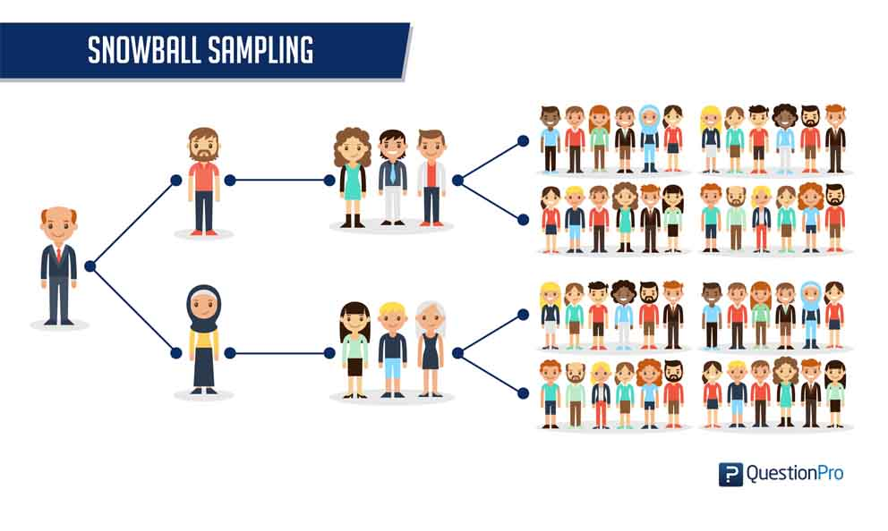

Slide 22
Probability (or) Random Sampling Methods
A) Simple Unrestricted Random Sampling
In simple random sampling (SRS) each and every unit of the population has an equal opportunity of being selected in the sample.
Items get selected in the sample is just a matter of chance, personal bias of the investigator does not influence the selection.
Here all the items of the sample are selected independently of one another and all ‘ N ’ items in the population have the same chance of being included in the sample.
To ensure randomness of selection one may adopt either the lottery method or consult table of random numbers.

Slide 23
Lottery Method
This is a very popular method of taking a random sample. Under this method, all the items of the universe are numbered or named on separate slips of paper of identical size and shape.
These slips are then folded and mixed up in a container or drum. A blindfold selection is then made of the number of slips required to constitute the desired sample size.
The selection of items thus depends entirely on chance.
The above method is very popular in lottery draws where a decision about prizes is to be made.

Slide 24
Table of Random Numbers
The lottery method discussed above becomes quite cumbersome as the size of population increases. An alternative method of random selection is that of using the table of random numbers.
The random numbers are generally obtained by some mechanism where the individuals bearing the numbers chosen from the Tables of Random Numbers will constitute a random sample.
An important characteristic of the Tables of Random Sampling is that we may start reading numbers on any page, in any direction (row-wise or column wise), the numbers so obtained are random numbers.

Slide 25
Several standard tables of random numbers are available, among which Tippett’s (1927) random numbers table has been tested extensively for randomness.
It is consisting of 41,600 random digits.
Tippett’s table of random numbers is most popularly used in practice.
We give below the first forty sets from Tippett’s table as an illustration of the general appearance of random numbers.

Slide 27
It is important that the starting point in the table of random numbers be selected in some random fashion so that every unit has an equal chance of being selected.
Tippett’s numbers have been subjected to numerous tests and used in many investigations and their randomness has been well established for all practical purposes.
An example to illustrate how Tippett’s table of random numbers may be used is given below. Suppose we have to select 20 items out of 6,000.
The procedure is to number all the 6000 items from 1 to 6000.

Slide 28
A page from Tippett’s table may then be consulted and the first twenty numbers up to 6000 noted down.
Items bearing those numbers will be included in the sample. Making use of the portion of the table given above the required numbers are:
Since the selection of items in the sample depends entirely on chance there is no possibility of personal bias affecting the results.

Slide 29
Restricted Random Sampling
1. Stratified Sampling
1. Base of Stratification
2. Number of Strata
3. Sample Size within Strata
Proportional and dis-proportional Stratification
2. Systematic Sampling
3. Multi-stage Sampling or Cluster Sampling

Slide 30
1. Stratified Sampling
Here the universe to be sampled is sub-divided or stratified into groups which are mutually exclusive and include all items in the universe.
mutually exclusive: if both cannot occur at the same time
A simple random sample is then chosen independently from each group or strata.
Basis for stratification: Strata should be constructed in such a way that it should minimize differences among sampling units within strata and maximize difference among strata.

Slide 31
Proportional and Disproportional Stratified Sampling
In proportional sampling one samples each stratum in a proportion to its relative weight such as population or workers or students. In disproportional sampling an equal number of cases are taken from each stratum.
As a general rule when variability among observations within a stratum is high, one may has to take more sample units/size than the strata with less internal variation.

Slide 32
Proportional sampling example: if you have 3 strata with 100, 200 and 300 population sizes respectively and the researcher chose a sampling fraction of 10% from each strata. Then, the researcher must randomly sample 10, 20 and 30 sample units from each stratum respectively.
In disproportional sampling an equal number of cases are taken from each stratum i.e 20, 20 and 20 from each stratum.
Stratum | A | B | C
Population Size | 100 | 200 | 300
Sampling Fraction | 10% | 10% | 10%
Final Sample Size | 10 | 20 | 30

Slide 33
2. Systematic Sampling
A systematic sample is formed by selecting one unit at random and then selecting additional units at evenly spaced intervals until the sample has been formed.
This method is popularly used in those cases where a complete list of the population is available.
Where k= sampling interval, N= Size of Universe and n= Sample Size

Slide 34
3. Multi-stage Sampling or Cluster Sampling
Under this method the random sampling is made at primary, intermediate and final levels.
There are several stages in which the sampling process is carried out.
In the first stage, units are sampled by some suitable method, such as simple random sampling method.
Then second stage units are selected from the units selected in first stage again by some suitable method either by the same method that was adopted in the first stage or by different method.
Similarly third stage selection of units are carried out.

Slide 35
Difference Between Stratified And Cluster Sampling
In Cluster Sampling, the sampling is done on a population of clusters therefore, cluster/group is considered a sampling unit.
In Stratified Sampling, elements within each stratum are sampled.
In Cluster Sampling, only selected clusters are sampled.
In Stratified Sampling, from each stratum, a random sample is selected.

Slide 36
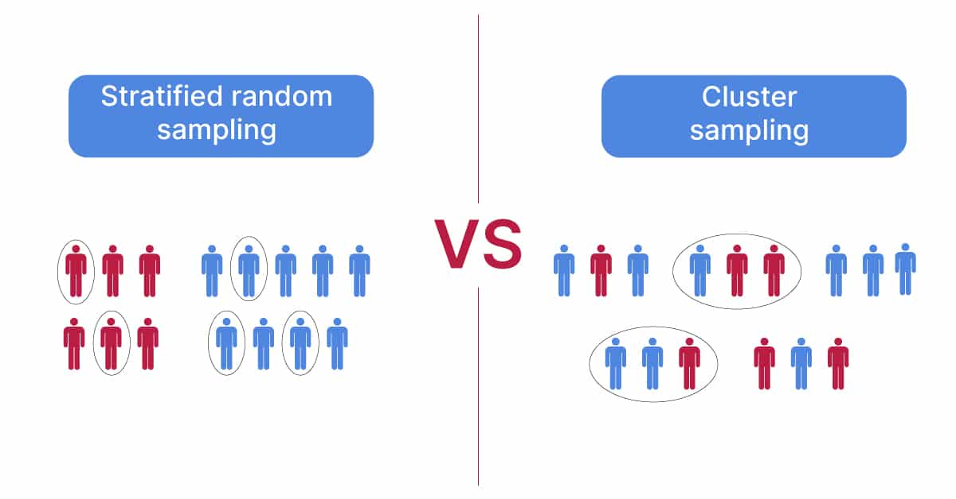

Slide 37
Thank you

